Slide 1

Have your say on:
The place of Learning for Sustainability in the GTC Scotland Accreditation Process and Requirements Review consultation
Tuesday 03 March 16:00 – 17:00March 16:00 – 17:00

Slide 2
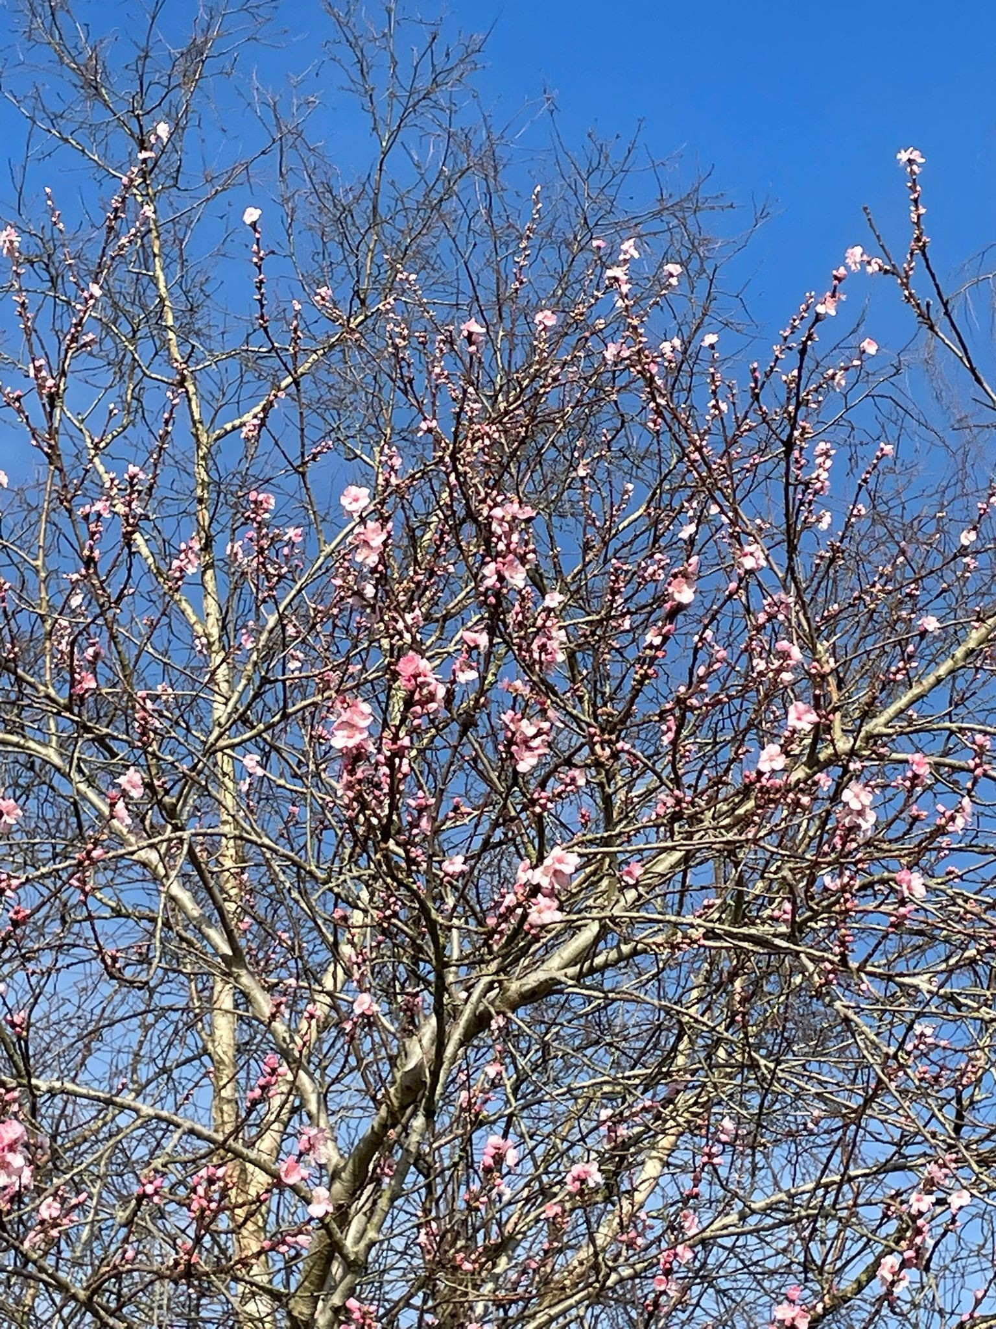
Welcome
Please…
Introduce yourself in the chat box
Mute your audio
Put any questions in the chat box.

Slide 3
Webinar overview
16:00 Welcome, introduction, and aims
Cecilia Mañosa Nyblon, Learning for Sustainability Scotland
16:15 Setting the scene
Professor Lizzie Rushton, University of Stirling
16:20 Group conversations
All participants
16:45 Summary and next steps
17:00 Close

Slide 4


Introduction and Aims Cecilia Mañosa Nyblon Learning for Sustainability Scotland

Slide 5
Aims of this webinar
Find out more about the proposed accreditation process and requirements review proposed by GTC Scotland.
Encourage discussion and gather insights/perspectives on the format of the review and the place of Learning for Sustainability in this.
Collate input from participants to inform a response from LfSS to the Consultation
Support and encourage participants to submit their own informed, independent contributions to the Consultation
Deadline for responses to the Consultation: Thursday 12th March 2026

Slide 6

Setting the scene Professor Lizzie Rushton University of Stirling

Slide 7
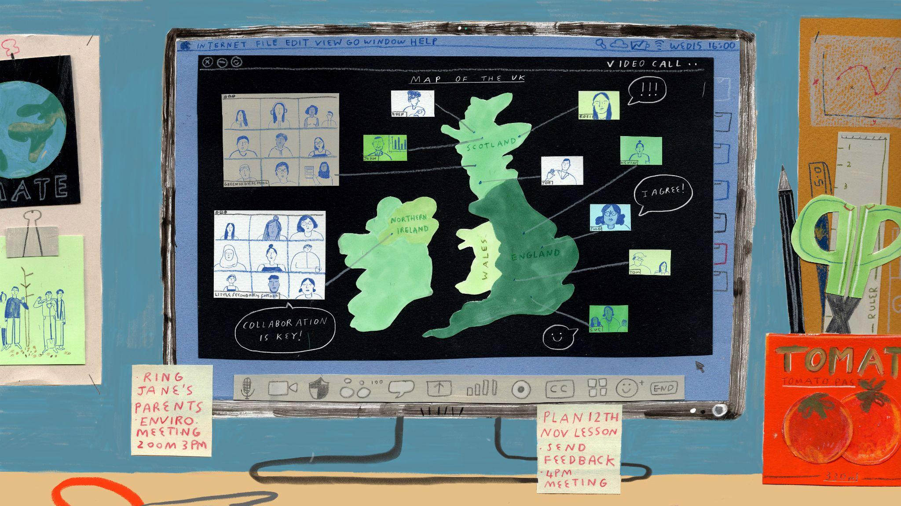



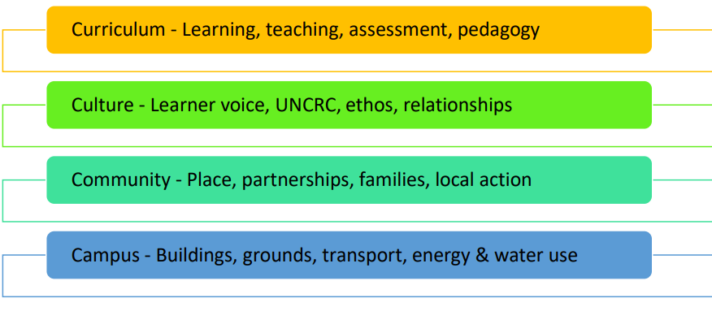
Context of LfS in Scotland
Scotland – Learning for Sustainability – brings together:
Education for Sustainable Development
Global Citizenship Education
Outdoor Learning
Integral to teachers’ and headteachers’ professional standards.
The four areas of Sustainable Learning Settings
(LfS Action Plan 2030)

Slide 8

LfS & the GTCS
Since 2013: LfS in GTCS Standards for ITE, teachers’ career-long professional learning & leadership.
‘...actively support, embrace and promote the principles and practices of sustainability across all aspects. This means understanding and valuing the environment, culture and heritage, developing a sense of place and belonging to the local, national and global community. It also means having a deep connection to the natural world and understanding the significance of the choices we make – now and in the future.’
Professional Standards for teachers (GTCS, 2021, p.3)
‘All Learners Matter’ – National Discussion
Issues of climate change and global warming were at the heart of many of the discussions we heard. The environment that children and young people will inherit is clearly of major and pressing concern. We heard a great deal of passion from the children and young people we spoke to about saving the planet, climate change, and upholding their rights. We also heard fears and anxieties, from them, about living in a world that is dramatically changing and evolving.
(Campbell & Harris, 2023, pp.21–22)

Slide 9
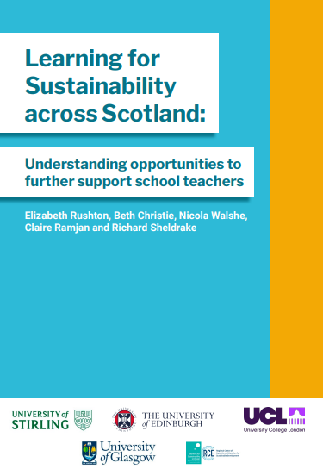
National Survey of LfS in Scotland
Two key findings which are of significance to this conversation:
Celebrate the value of LfS: Teachers in Scotland view LfS as integral to their professional role, regardless of whether they have formally engaged in LfS education or training. This suggests that embedding LfS within the GTCS professional standards is now visibly shaping teachers' practices, reinforcing that LfS is part of what it means to be a teacher in Scotland.
Strengthen role of ITE: Findings illustrate the critical role ITE plays in preparing teachers to embed LfS from the outset of their careers. This focus should be retained and strengthened, including through the National Framework for LfS in ITE.
Access the National Framework & the Survey report here: https://www.scde.ac.uk/learning-for-sustainability-in-ite
Notes:
Total: 545 responses
National reach: All 32 local authorities in Scotland
Cross-sectoral: Early years, nursery or primary schools, secondary schools, colleges and universities, and other work settings.
Range of prior LfS ‘education’: including those who have not actively engaged with LfS professional learning and networks.

Slide 10
Group conversations Kirsten Leask Learning for Sustainability Scotland

Slide 11
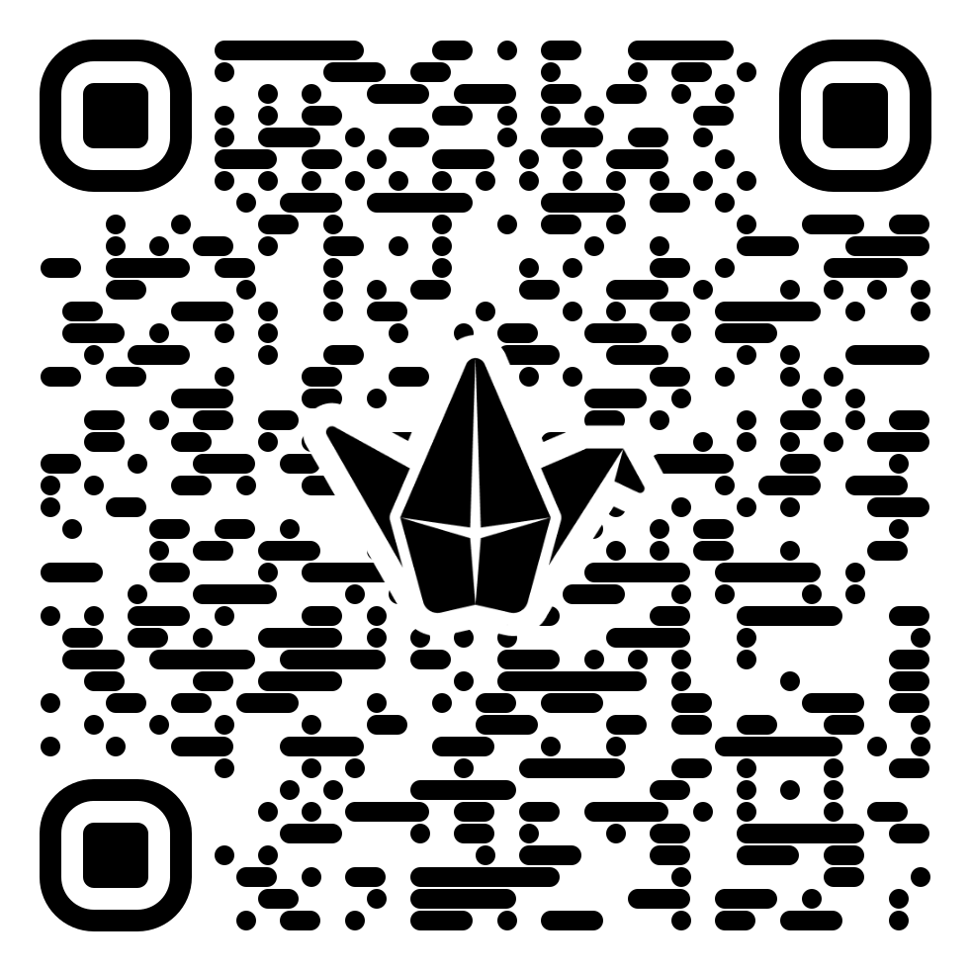
The GTC Scotland consultation: an opportunity for LfS
We have selected three key areas of the Consultation for discussion:
Q7: Teacher educators and programme staffing
Q8: Assessment of individuals undertaking teaching qualifications programmes
Q9: Accreditation, application, assessment and duration
Please use our Padlet to share your thoughts on these, and any other comments you wish to share. A link to the consultation information for each question is given next to each
Access the Padlet here: The GTC Scotland Accreditation Process and Requirements Review consultation. It will remain open after this webinar if you’d like to come back and add any additional reflections.
Notes:
Padlet link: The GTC Scotland Accreditation Process and Requirements Review consultation

Slide 12

Group feedback Professor Lizzie Rushton University of Stirling

Slide 13
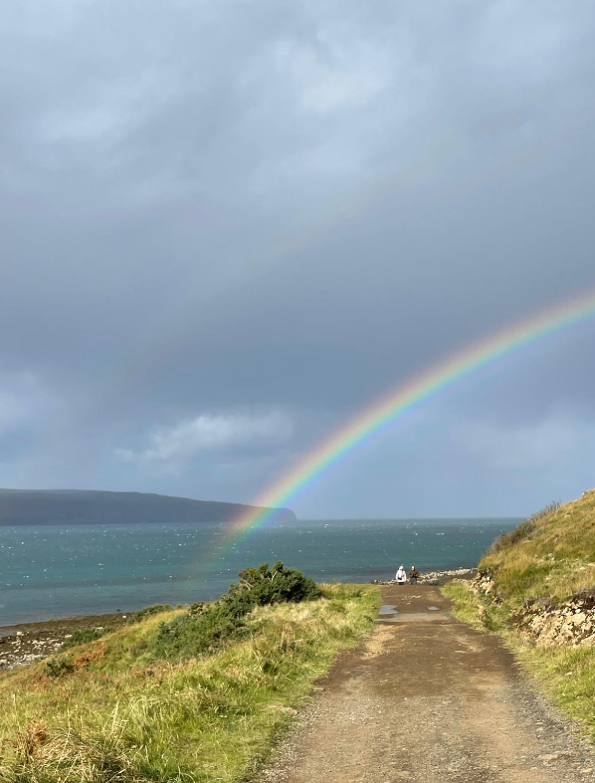
Next steps Cecilia Mañosa Nyblon Learning for Sustainability Scotland

Slide 14
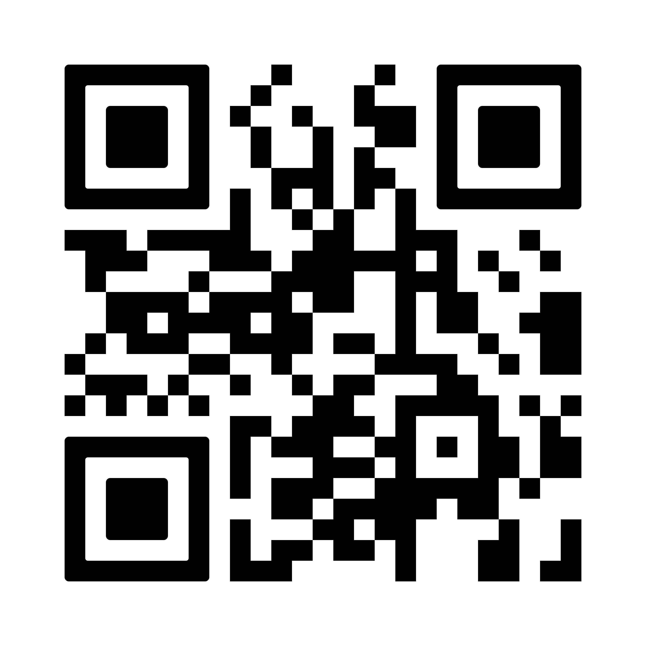
Join us!
www.learningforsustainabilityscotland.org

